Slide 1
SCM 651: Business Analytics
Week 8

Slide 2
Agenda
Review of homework #3
Overview of homework #4
Review of hands-on exercises
Video of neural network application to game of Go
Walkthrough of logit, probit and neural network prediction & sensitivity analysis (time permitting)
Group discussion of articles
An introduction to data mining and other techniques for advanced analytics
Recent neural network stories in the news

Slide 3
Homework #3
Graph, regression, calculated sales, revenue, profit
Constrained optimization
Discussion of risks, other data which would be valuable

Slide 4
Homework #4
Logit and probit analysis (week 8)
Moderating effects (week 7)
Final logit & probit models with interaction effects (moderating effects), prediction of outcome, sensitivity analysis
Neural network analysis (week 8)
Neural network prediction model and sensitivity analysis (week 8)

Slide 5
Week 8 – Choice Models
Choice models have Y-variables that are zero or one, e.g., when a customer enters a store, do they buy a TV or not
Some techniques to represent choice models include logit, probit, and neural networks
Logit and probit have Y-variables which are binary (zero or one) and predict probabilities
Logit and probit have s-shaped curves (monotonic) – always increasing or always decreasing
Neural networks are not limited to monotonic behavior or binary Y-variables

Slide 6
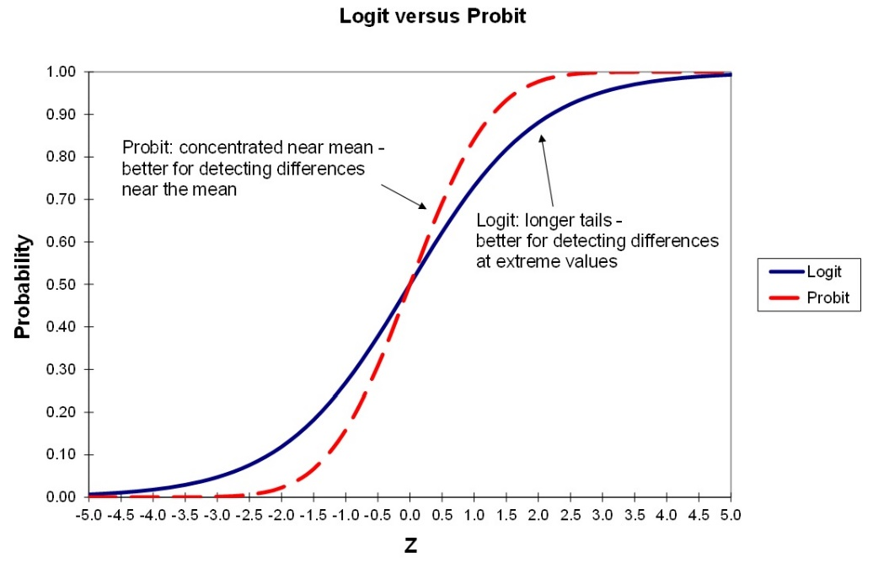
Week 8 – Logit vs. Probit
Logit uses the logistic distribution and is more sensitive to extreme values of X
Probit uses the normal distribution and is more sensitive near the mean of X

Slide 7
Week 8 – Logit vs. Probit
Logit & Probit
Dependent variable is binary (0,1)
Predict probabilities
Logit
Logistic distribution
More sensitive in detecting differences at extreme values of your variables
Probit
Normal distribution
More sensitive in detecting differences at values near the mean of your variables

Slide 8
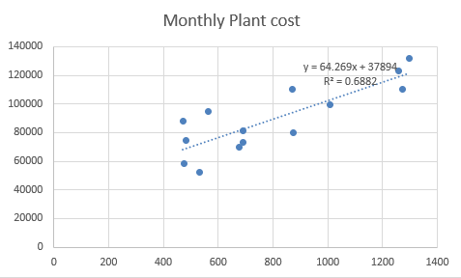
Week 8 – Linear Regression Review
Linear regression finds the line that best fits the data by minimizing the square of the error terms (residuals)

Slide 9
Week 8 – Linear Regression Review
The linear regression equation can be represented as:
Monthly Plant Cost = 37894 + 64.269 * Units Produced

Slide 10
Week 8 – Logit & Logistic Function
Logit & logistic function
For binary Y-variables, logit creates an s-shaped curve using the logistic function
Always increasing or always decreasing

Slide 11
Week 8 – Logistic Function
The logistic function is:
f(X) = exp(∑β_{i}X_{i}) / (1 + exp(∑β_{i}X_{i}))
Where:
β_{i} = the coefficients in a logit regression
Xi = the variables in a logit regression

Slide 12
Week 8 – Logistic Function
Pictorially, this looks like:

Slide 13
Week 8 – Neural Networks
Neural networks
Uses the logistic function to build relationships
Also has at least three levels, the X input variables, one or more hidden layers of variables, and the Y output variables
To predict the neural network outcome:
First, predict the hidden variables from the inputs, just like a logit prediction
Second, predict the Y output variables from the hidden variables, again like a logit prediction
More than two hidden layers is deep learning
Neural networks can predict probabilities (0-1) or continuous numbers (e.g., house prices)

Slide 14
Week 8 - Neural Networks
Neural networks can have:
Multiple inputs
One or more hidden layers
Two or more hidden layers are called deep learning
One or more outputs
Outputs can be binary (0-1) or continuous

Slide 15
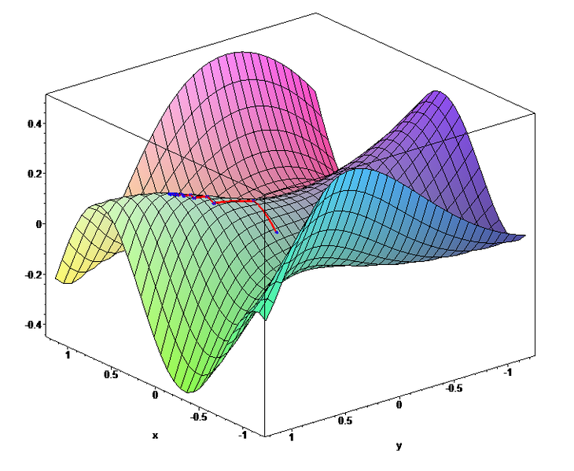
Week 8 - Neural Networks
The back propagation algorithm uses gradient search (hill-climbing) to find the best solution
It randomly selects a starting point, then calculates the slope and climbs the hill
When there are multiple hills, it sometimes get stuck in a local optimum

Slide 16
Week 8 - Neural Networks
Advantages
Can have binary or linear outputs
Can have one or more outputs
Can represent any mathematical relationship
Have been used in voice recognition and speech generation (SIRI), photo recognition (law enforcement), and self-driving cars (Tesla)
Fast to make decisions after they have learned
Disadvantages
Can get stuck in local optima; need to run several times
Slow to learn

Slide 17
Week 8 – Deep Learning
Neural networks:
Deep learning neural networks have two or more hidden layers
Deep learning can learn complex patterns such as voice recognition, voice generation, photo recognition

Slide 18
Week 8 – Neural Network Prediction and Sensitivity Analysis
In-class example
Logit analysis of Titanic survivor data
Creation of prediction model of logit results
Sensitivity analysis of logit results
Neural network analysis of Titanic survivor data
Creation of a prediction model of neural network results
Sensitivity analysis of neural network results

Slide 19
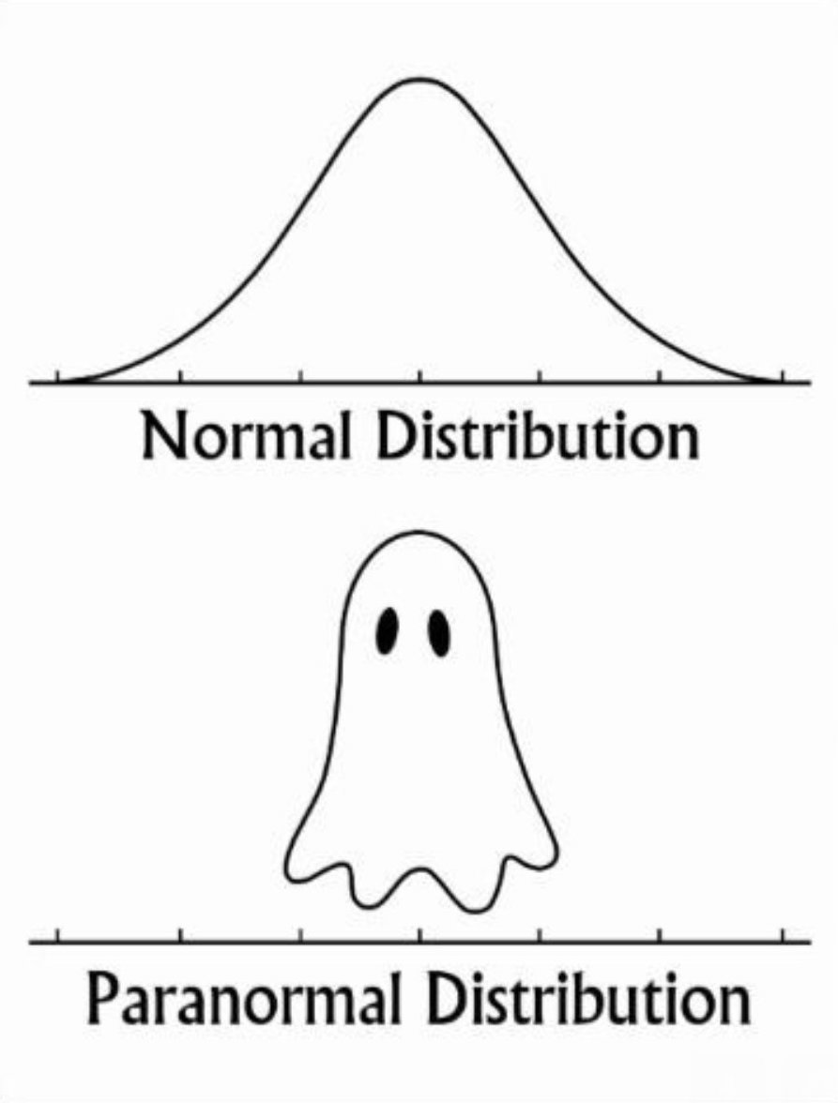
Normal Distribution

Slide 20
Article #1: An Introduction to Data Mining and Other Techniques for Advanced Analytics
An introduction to data mining and other techniques for advanced analytics
What are the key differences between statistical analysis and data mining? (page 140)
Describe tools for advanced analytics (page 149-151)
Data visualization
Text mining
Social network analysis
Contact optimization
How do you mitigate the risks of data mining? (page 152)

Slide 21
Article #1: An Introduction to Data Mining and Other Techniques for Advanced Analytics
An introduction to data mining and other techniques for advanced analytics
What are the key differences between statistical analysis and data mining? (page 140)
Creation of a hold-out sample
Use the hold-out sample to test the model
Describe tools for advanced analytics (page 149-151)
Data visualization: scatter plots and heat maps, geographic data
Text mining: extract structure from unstructured text files
Social network analysis: identify networks of calling circles, influencers
Contact optimization: best solution for customers calling in and marketers calling out

Slide 22
Article #1: An Introduction to Data Mining and Other Techniques for Advanced Analytics
An introduction to data mining and other techniques for advanced analytics
How do you mitigate the risks of data mining? (page 152)
Focus on good data quality, strong business focus, sound user training

Slide 23
Neural Network Applications
Gaming
1989: Deep Thought – Carnegie Mellon chess program lost to Gary Kasparov (not Neural Network)
1997: Deep Blue – IBM chess program beat Gary Kasparov (not Neural Network)
2011: IBM Watson beat Jeopardy champions (not Neural Network)
2014: DeepMind set world record for video game Breakout, learned to play Space Invaders, Ms Pac-Man, Q*Bert
2016: Google DeepMind AlphaGo beat Go world champion
Video https://www.youtube.com/watch?v=8tq1C8spV_g
2017 (Jan): AlphaGo Master won 60 straight Go matches
2017 (Oct): AlphaGo Zero learned game without human intervention; beat all previous versions, winning 100-0
2017 (Dec): AlphaGo Zero generalized to learn chess, shogi, and Go in less than 24 hours, beating all previous champion systems

Slide 24
Neural Network Applications
Self-driving vehicles
1984-92: Self-driving cars (Navlab, ALVINN)
2005: DARPA Grand Challenge – self-driving competition over 132 miles (212 km)
2007: DARPA Urban Challenge – self-driving competition through city traffic
Voice recognition
2010: SIRI voice assistant
2014: SIRI/Shazam music recognition

Slide 25
Neural Network Applications
Latest Advances
November 2016: Google Brain develops encryption algorithms
March 2017: DeepStack defeats poker champions, develops intuition
July 2017: Facebook AI develops own language
August 2017: AI defeats world champions in multi-player game (Dota 2 [Defense of the Ancients])
May 2019: DeepMind AI uses teamwork to defeat human 'Quake III' players
Neural network created a 3D replica of the universe – July 2019
Neural network detects Covid-19 in real time by Xray – June 2020
Neural network detects COVID-19 via coughs (MIT) – November 2020
Wearable device app CovidDeep detects COVID-19 – Jan 2021

